Slide 1

CS401 Modern Programming Practices (MPP) Dr. Shafqat Ali Shad
MAHARISHI UNIVERSITY of MANAGEMENT
Engaging the Managing Intelligence of Nature
Computer Science Department

Slide 2
© 2015 Maharishi University of Management, Fairfield, Iowa
All rights reserved. No part of this slide presentation may be reproduced or utilized in any form or by any means, electronic or mechanical, including photocopying or recording, or by any information storage and retrieval system, without permission in writing from Maharishi University of Management.

Slide 3
Lecture 7: Interfaces in Java 8 and the Object Superclass

Slide 4
Wholeness Statement
Java supports inheritance between classes in support of the OO concepts of inherited types and polymorphism. Interfaces support encapsulation, play a role similar to abstract classes, and provide a safe alternative to multiple inheritance. Likewise, relationships of any kind that are grounded on the deeper values at the source of the individuals involved result in fuller creativity of expression with fewer mistakes.

Slide 5
Overview
Java 8 introduces many new features in interfaces and applications of these features to the collections library
The Object class is the superclass of all Java classes. It offers several important methods (usable by any Java class), but to be useful, they must be overridden (in the right way)

Slide 6
Java 8 Features of Interfaces
Before Java 8, none of the methods in an interface had a method body; all were unimplemented.
In Java 8, two kinds of implemented methods are now allowed: default methods and static methods. Both can be added to legacy interfaces without breaking code.

Slide 7
A default method is a fully implemented method within an interface, whose declaration begins with the keyword default
A static method in an interface is a fully implemented static method having the same characteristics as any static method in a class.
See Demos in package lesson7.lecture.defaultmethods and lesson7.lecture.interfacestatic

Slide 8
New Programming Style
Default Methods in an interface eliminate the need to create special classes that represent a default implementation of the interface.
Examples from pre-Java 8 of default implementations of interfaces: WindowListener / WindowAdapter, List / AbstractList.
Now, in developing new code, it is possible in many cases to place these default implementations in the interface directly.
Static Methods in an interface eliminate the need to create special utility classes that naturally belong with the interface.
Examples from pre-Java 8 of how interfaces sometimes have companion utility classes (consisting of static methods): Collection / Collections, Path / Paths.

Slide 9
Solution to Evolving API Problem
When you need to add new methods to an existing interface, provide them with default implementations using the new Java 8 default feature. Then
legacy code will not be required to implement the new methods, so existing code will not be broken
new functionality will be available for new client projects.

Slide 10
Other Uses
First Set of Examples:
enums can now “inherit” from another type
Second Set of Examples:
forEach – default method in Iterable

Slide 11
First Set of Examples: Review of Enums
An enumerated type is a Java class all of whose possible instances are explicitly enumerated during initialization.
Example:
public enum Size { SMALL, MEDIUM, LARGE};
//usage: if(requestedSize==Size.SMALL)
applyDiscount();
The enum Size (which is a special kind of Java class) has been declared to have just three instances, named SMALL, MEDIUM, LARGE.

Slide 12
Review of Enums
Two important applications for enums:
Provide a list of related “constants” for an application
Weak programming practice: Create a class (or interface) containing constants, stored as public static final values Problem. No compiler control over usage of constants
Better approach when constants are related to each other: Represent constants as instances of an enumerated type.
Optimal, threadsafe implementation of the Singleton Pattern

Slide 13
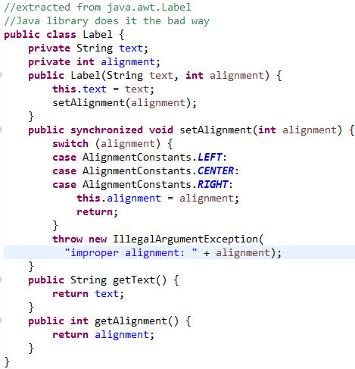
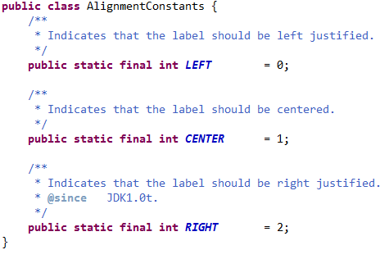
Example: Improve style of managing constants with enums
In the java.awt package there is a class Label, used to represent a label in a UI (built from the old AWT). It makes use of constants to designate alignment properties: left, center, right. This use of constants is flawed, but it is a commonly used style

Slide 14
Problem: No compiler control over use of these constants. Could make the following call: Label label = new Label(“Hello”, 23);
You won’t know till you run the code that “23” is meaningless. The compiler sees that a value of the correct type has been used, but 23 should not be used here. It is better to control the values passed in with the help of the compiler. This is accomplished using an enum to store constants, rather than collecting together a bunch of public static final integers.

Slide 15
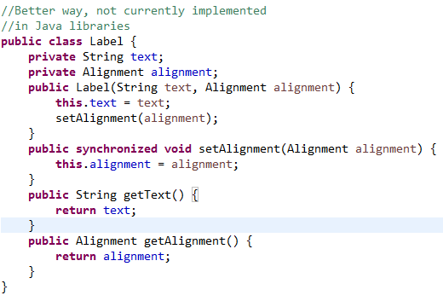
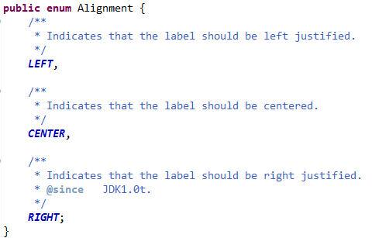
Improved Label Using enums

Slide 16
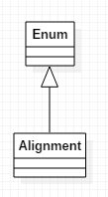
Review of Enums
In the example, each of the instances declared within the Alignment enum has type Alignment, which is a subclass of Enum. Therefore
Alignment is itself a class
Alignment may not inherit from any other class ( since there is no multiple inheritance).

Slide 17
First Set of Examples: Using enums to Create Singletons
A singleton class is a class that can have at most one instance
Easy implementation using an enum:
enum MySingleton {
INSTANCE;
public void behavior() {}
}
//access it like this:
MySingleton.INSTANCE.behavior();
Demo: lesson7.lecture.singletons

Slide 18
First Set of Examples: In Java 8, Enums Can “inherit”
interface MyInterface {
default usefulThings() {
. . .
}
}
enum MySingleton implements MyInterface {
INSTANCE;
@Override
public void behavior() {
. . .
usefulThings();
}
}

Slide 19
Second Set of Examples: forEach
The Iterable interface is part of the Collections API that is implemented by all collection classes, and supports iteration through a collection
The only method in Iterable is iterator(), which returns an Iterator
Iterator has two methods:
hasNext()
next()
When a class (even user-defined) implements the Iterable interface, the “for each” construct can be used (and of course, an instance of Iterator is available).
See Demo: lesson7.lecture.iterator

Slide 20
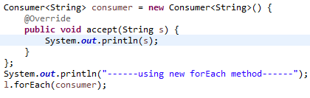

New (Java 8) in the Iterable interface is a default method:
forEach
Sample usage:
Output:
See Demos:
lesson7.lecture.iterator
Review inner classes:
Lesson7.lecture.reviewinner

Slide 21
The forEach method applies the Consumer method accept to each element of the list.
In this example, the accept method just prints the value to the console.
Consumer is a new interface in Java 8, with just one abstract method accept, which accepts a single argument and produces no return value.

Slide 22
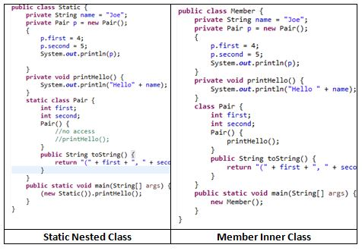
Quick Review of Nested Classes I

Slide 23
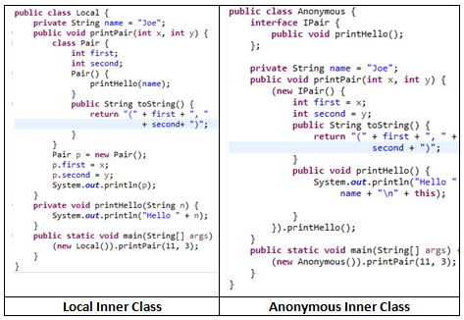
Quick Review of Nested Classes II

Slide 24
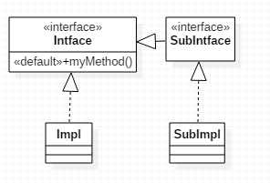
Rules for Default Methods in an Interface
If a class implements an interface with a default method, that class inherits the default method (or can override it).
Potential clash if
two interfaces have the same method, or
one interface and a superclass have the same method

Slide 25
Interface vs Interface – clash! When two interfaces each have a method with the same signature:
If one of these is a default method, any implementer of both interfaces must override the method (or declare it as an abstract method) – can’t simply do nothing.
If one of these is a default method, any subinterface of both interfaces must provide a default method (i.e. an implementation) of this method, or declare the method (even if unimplemented). (This rule requires no special effort.)
Note: Even in Java 7, it is not possible to implement two interfaces each of which has a method with the same signature but different return types.

Slide 26
Superclass vs Interface – superclass wins! When a class extends a superclass and also implements an interface, and both super class and interface have a method with the same name, the superclass implementation wins – this is the version that is inherited by the class. The subclass/implementer is not required to override the shared method.
See Demos in lesson7.lecture.defaultmethodrules

Slide 27
Static Methods Do Not Clash
Static methods defined in an interface are not inherited by implementers (this differs from the behavior for subclasses of a class)
Therefore, if two interfaces implement static methods with the same signature, there is no clash to address when a class implements these interfaces.
Static methods can always be accessed in a static way in such cases, but it is not related to inheritance. See demo lesson7.lecture.interfacestatic_clash

Slide 28
Main Point 1
Interfaces are used in Java to specify publicly available services in the form of method declarations. A class that implements such an interface must make each of the methods operational. Interfaces may be used polymorphically, in the same way as a superclass in an inheritance hierarchy. Because many interfaces can be implemented by the same class, interfaces provide a safe alternative to multiple inheritance. Java8 now supports static and default methods in an interface, which make interfaces even more flexible: For instance, enums can now “inherit” from other types and new public operations can be added to legacy interfaces without breaking code (as was done with the forEach method in the Iterable interface). The concept of an interface is analogous to the creation itself – the creation may be viewed as an “interface” to the undifferentiated field of pure consciousness; each object and avenue of activity in the creation serves as a reminder and embodiment of the ultimate reality.

Slide 29
Overriding Methods in the Object Class
The Object class is the superclass of all Java classes, and contains several useful methods
-- in most cases, they are useful only if they are overridden.
toString
equals
hashCode

Slide 30
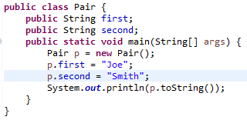
The toString() Method
Every class automatically is equipped with a toString method (by inheritance), but the default implementation simply prints out the class name followed by a code for a memory location. Example:
(Useless) output: tostring.Pair@19e0bfd

Slide 31
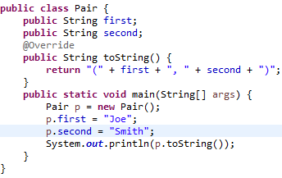
When toString() is overridden, it is possible to capture the state of the current instance of the class and send it to a log file or to the console. This can help in solving a problem after the code has been released, and in debugging during development. Note the @Override annotation.
Output: (Joe, Smith)

Slide 32

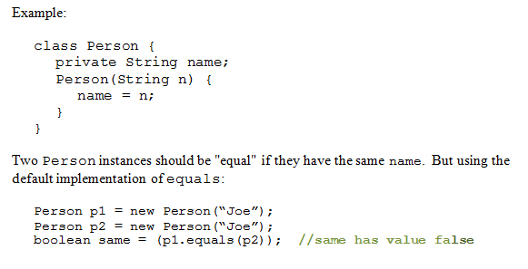
Overriding equals()
Default implementation in Java is same as ==

Slide 33
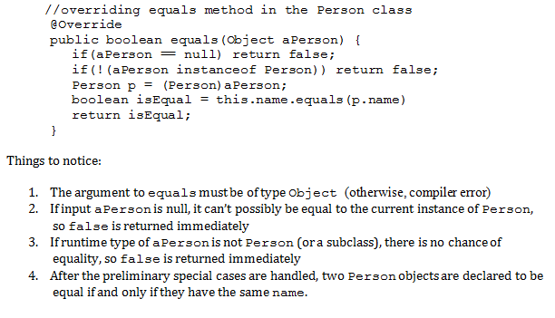
Correct Way to Do It

Slide 34
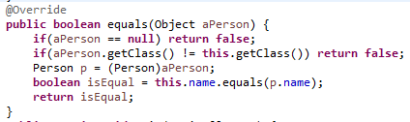
Alternative Approach
To check that the aPerson object is of the right type we used instanceof operator. This is called the instance-of strategy for overriding equals.
An alternative is to call getClass on aPerson to see if it matches the value of getClass for the current object, called the same-classes-strategy for overriding equals

Slide 35
Potential problem with same-classes-strategy: If a subclass of Person is introduced, subclass inherits the equals method but it always returns false when comparing a superclass instance with a subclass instance. For this reason, whenever same-classes strategy is used, you should either:
1. declare the superclass final (to prevent subclassing) or
2. override equals separately in the subclass
See Demos lesson7.lecture.overrideequals.equalclassesstrategyXX

Slide 36
Potential problem with instance-of-strategy: If a subclass of Person is introduced, subclass inherits the equals method. If subclass overrides equals, then an asymmetric equals is created. For this reason, whenever instance-of strategy is used, you should either:
1. declare the superclass final (to prevent subclassing) or
2. require that every subclass relies on the superclass version of equals() (and does not override equals() separately)
See Demos lesson7.lecture.overrideequals.instanceofstrategyXX

Slide 37
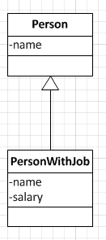
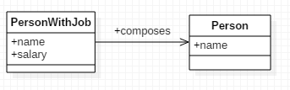
A third alternative: Composition instead of Inheritance
Using separate equals methods for superclass and subclass using either approach (equal-classes or instanceof strategy) is error-prone.
Safe alternative: Replace inheritance with compositon:
CHANGE
TO

Slide 38
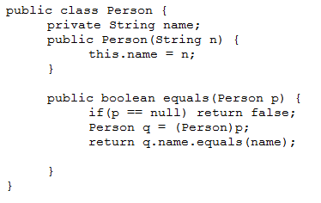
Exercise
Explain with an example how this way of “overriding” equals leads to logic errors in your code:

Slide 39
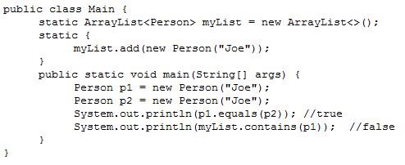
Solution
This version of equals correctly compares two Person objects. The difficulty arises when the Object version of equals needs to be called, and there is no overriding version of equals. This happens (for example) when you want to test whether an object is contained in a List.

Slide 40
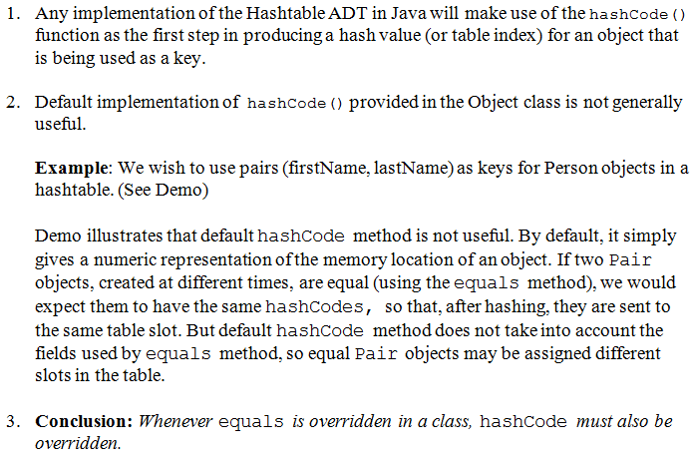
Overriding hashCode()
DEMO: lesson7.lecture.hashcode.xxx

Slide 41
hashCode() Rules
To use an object as a key in hashtable,
you must override equals() and hashCode()
the class on which object is based should be immutable (slide 41) – see demo lesson7.lecture.hashcode.bad3
If k₁,k₂ are keys and k₁.equals(k₂) then it must be true that [k₁.hashCode() == k₂.hashCode()] This means that you must include the same information in your hashCode definition as you include in your implementation of equals.

Slide 42
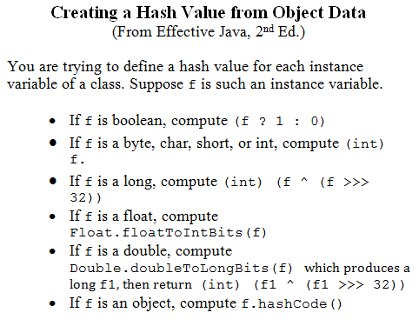

Slide 43
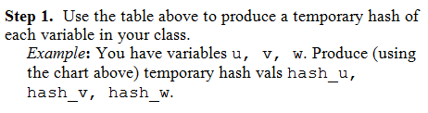
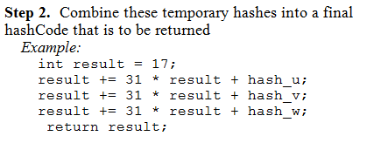
Formula:

Slide 44
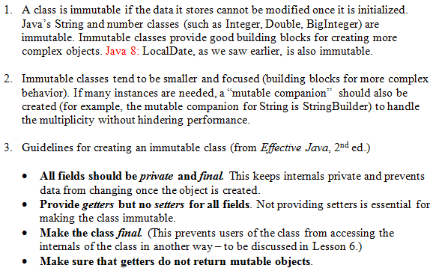
Review: Making Your Classes Immutable

Slide 45
Main Point 2
All classes in Java belong to the inheritance hierarchy headed by the Object class.
Likewise, all individual consciousnesses inherit from the single unified field.

Slide 46
Connecting the Parts of Knowledge With the Wholeness of Knowledge
Inheritance in Java makes it possible for a subclass to enjoy (and re-use) the features of a superclass.
All classes in Java – even user defined classes – automatically inherit from the class Object
Transcendental Consciousness is the field of pure awareness, beyond the active thinking level, that is the birthright and essential nature of everyone. Everyone “inherits” from pure consciousness
Wholeness moving within itself: In Unity Consciousness, there is an even deeper realization: The only data and behavior that exist in the universe is that which is “inherited from” pure consciousness – everything in that state is seen as the play of one’s own consciousness.

